Slide 1
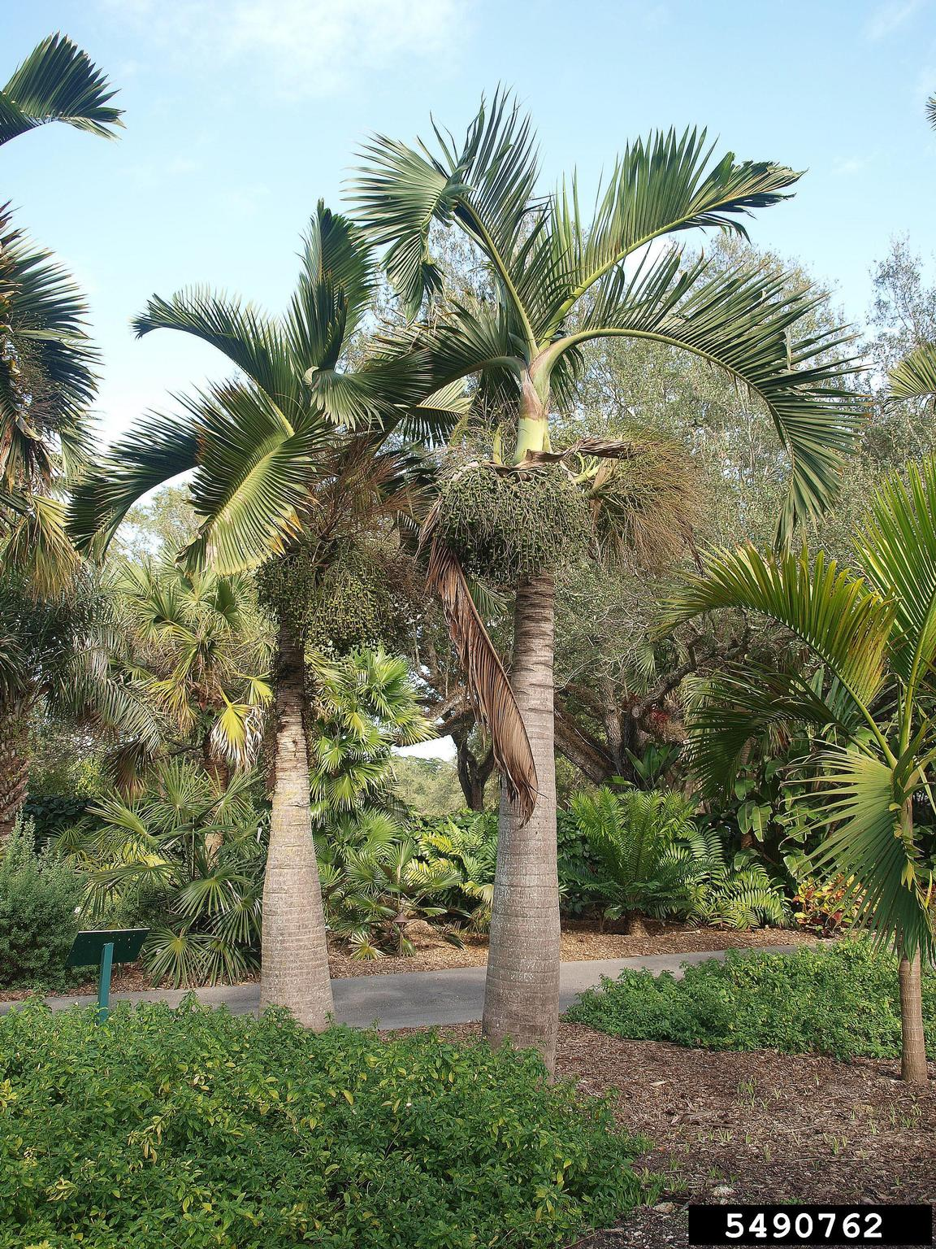
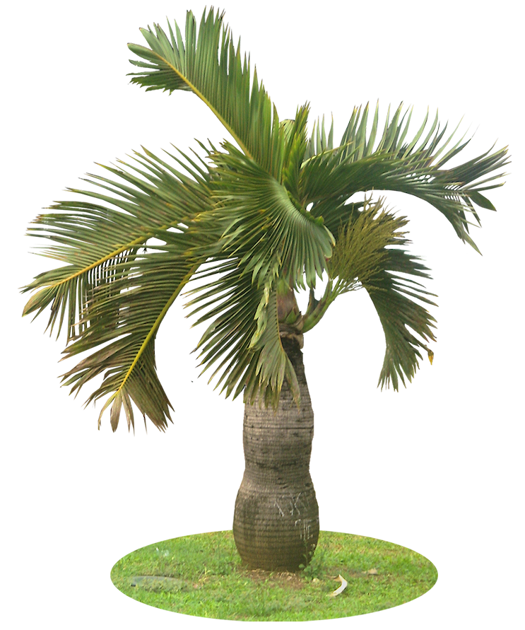
BOTTLE PALM

Slide 2
Common Name : Bottle Palm
Scientific Name : Hyophorbe lagenicaulis
Family Name : Arecaceae
Habit : The Bottle palm tree is a tropical plant known for its
distinctive, swollen trunk that resembles a bottle.
Distribution : The Bottle palm is native to Madagascar but is
widely cultivated in tropical and subtropical regions
around the world, including parts of Southeast Asia,
the Pacific Islands, and Northern Australia.

Slide 3
Description
The Bottle palm is a striking tropical plant characterized by its distinctive swollen, bottle-shaped trunk that tapers towards the top.
Its trunk is smooth, grayish-green, and typically grow to a height of about 10 to 15 feet.
The tree produces small, yellowish flowers that are not very conspicuous, followed by round, orange to red fruits.

Slide 4
Uses :
Ornamental Landscaping: Its unique bottle-shaped trunk and elegant
fronds make it a popular choice for decorative
purposes in gardens, parks, and urban landscapes.
Tropical Gardens: It adds a distinctive element to tropical garden, providing a visually interesting focal point.
Commercial Decoration: Its compact size and striking appearance make
it suitable for use in commercial spaces,
including lobbies.
Crafts: Parts of the tree, such as the leaves, can be used in making crafts,
decorations, or even in traditional weaving.

